Slide 1
UNIT IV: SERVICES

Slide 2
Services in Android
Services facilitates an application to run in the background in order to perform long-running operation tasks.
Service ensures that the application remains active in the background so that the user can operate multiple applications at the same time.
A Service is an application component that runs in the background, not interacting with the user, for an indefinite period of time.
Each service class must have a corresponding <service> declaration in its package's AndroidManifest.xml

Slide 3
Services in Android
Services can be started with Context.startService() and Context.bindService()
Execute in the main thread of the application’s process.
CPU intensive tasks must be offloaded to background threads using Thread or AsyncTask
Alarms can be used to fire Intents at set times (by OS, not your app). These can start services, open Activities, or broadcast Intents

Slide 4
Services in Android
A service can run continuously in the background even if the application is closed or the user switches to another application.
Thread - by the Operating system to perform operations in the background.
Service - an android component that performs a long-running operation

Slide 5
Types of Android Services
1. Foreground Services:
Services that notify the user about its ongoing operations are termed as Foreground Services.Users can interact with the service by the notifications provided about the ongoing task.
2. Background Services:
Background services do not require any user intervention. These services do not notify the user about ongoing background tasks and users also cannot access them.

Slide 6
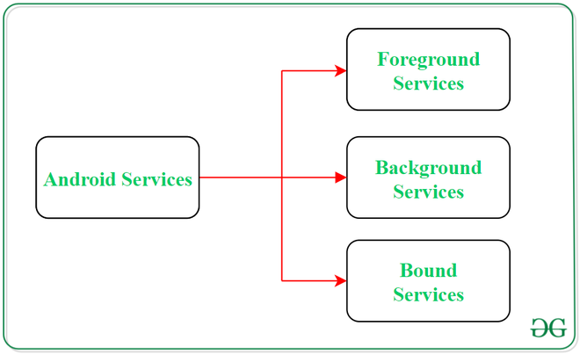
Types of Android Services
3. Bound Services:
This type of android service allows the components of the application like activity to bound themselves with it. Bound services perform their task as long as any application component is bound to it.

Slide 7
Services Lifecycle
services have 2 possible paths to complete its life cycle namely Started and Bounded.

Slide 8
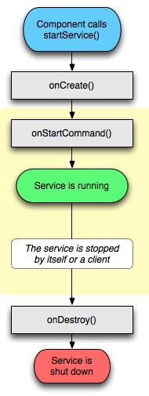
Services Lifecycle
A Service has three lifecycle methods:
void onCreate()
void onStart(Intent intent)
void onDestroy()

Slide 9
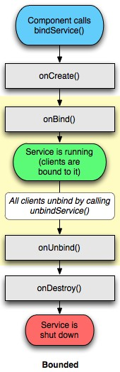
Services Lifecycle

Slide 10
Services Lifecycle
1. Started Service (Unbounded Service):
A service will initiate when an application component calls the startService() method.
Once initiated, the service can run continuously in the background even if the component is destroyed which was responsible for the start of the service.
Two ways to stop the execution of service:
By calling stopService() method,
The service can stop itself by using stopSelf() method.

Slide 11
Services Lifecycle
2. Bounded Service:
It can be treated as a server in a client-server interface. An android application components can send requests to the service and can fetch results.
A service is termed as bounded when an application component binds itself with a service by calling bindService() method.
To stop this service, all the components must unbind themselves from the service by using unbindService() method.

Slide 12
onStartCommand
Called whenever the Service is started with call to startService
So beware: may be executed several times in Service’s lifetime!
Controls how system will respond if Service restarted
(START_STICKY)
Run from main GUI thread so standard pattern is to create a new Thread from onStartCommand to perform processing and stop Service when complete

Slide 13
Stickyness
START_STICKY
onStartCommand called anytime service restarts
START_NOT_STICKY
For service started to execute specific action/command
Use stopSelf to terminate service when command complete
START_RECEIVER_INTENT
Combines both above

Slide 14
Stickyness
You can use the parameter passed to startService to determine if the service is a system-based restart
Null
Initial call
START_FLAG_REDILIVERY
OS terminated the service before it was stopped by stopSelf
START_FLAG_RETRY
Service restarted after an abnormal termination when
service was set to START_STICKY

Slide 15
Determining start condition
@Override
public int onStartCommand(Intent intent, int flags, int startId) {
if ((flags & START_FLAG_RETRY) == 0) {
// TODO If it’s a restart, do something.
}
else {
// TODO Alternative background process.
}
return Service.START_STICKY;
}

Slide 16
Starting a Service
Call startService
// Implicitly start a Service
Intent myIntent = new Intent(MyService.ORDER_PIZZA); myIntent.putExtra("TOPPING", "Margherita"); startService(myIntent);
// Explicitly start a Service
startService(new Intent(this, MyService.class));
(To use this example, would need to include a ORDER_PIZZA constant in MyService class and use an Intent Filter to register the Service as a provider of ORDER_PIZZA)

Slide 17
Stopping a Service
Call stopService
ComponentName service = startService(new Intent(this, BaseballWatch.class));
// Stop a service using the service name. stopService(new Intent(this, service.getClass()));
// Stop a service explicitly. try {
Class serviceClass = Class.forName(service.getClassName()); stopService(new Intent(this, serviceClass));
} catch (ClassNotFoundException e) {}

Slide 18
Binding to Services
Application components (clients) can bind to a service by calling bindService(). The Android system then calls the service's onBind() method, which returns an IBinder for interacting with the service.
- The binding is asynchronous. bindService() returns immediately and does not return the Ibinder to the client.
- To receive the IBinder, the client must create an instance of ServiceConnection and pass it to bindService(). The ServiceConnection includes a callback method that the system calls to deliver the IBinder.

Slide 19
Binding to Services
To bind to a service from your client
- Implement ServiceConnection. Your implementation must override two callback methods:
- onServiceConnected() The system calls this to deliver the IBinder returned by the service's onBind() method.
- onServiceDisconnected()
The Android system calls this when the connection to the service is unexpectedly lost, such as when the service has crashed or has been killed. This is not called when the client unbinds.
- Call bindService(), passing the ServiceConnection implementation.

Slide 20
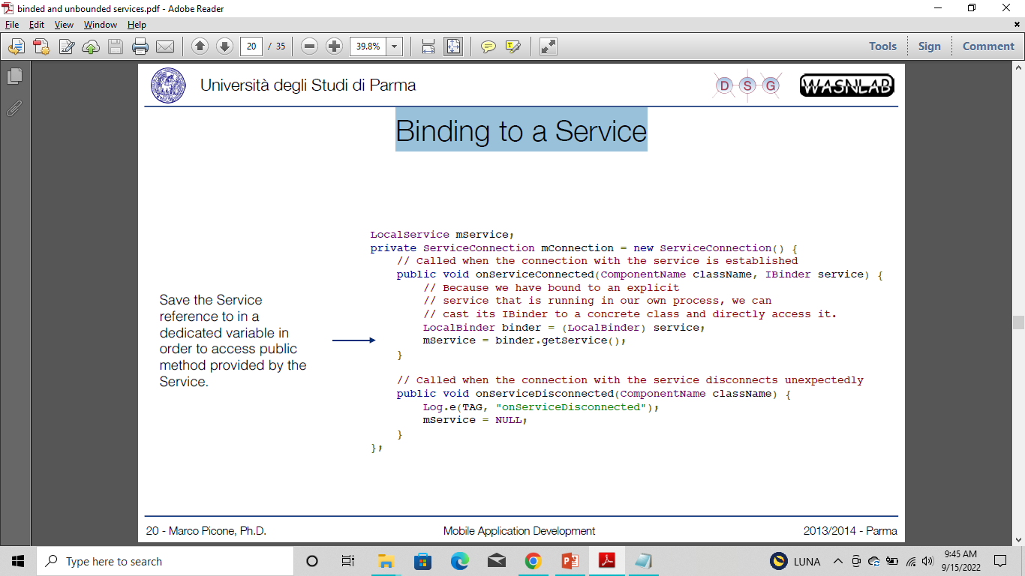
Binding to Services
To bind to a service from your client

Slide 21
Binding to Services
To bind to a service from your client
With this ServiceConnection, the client can bind to a service by passing this it to bindService().
For example:
- The first parameter of bindService() is an Intent that explicitly names the service to bind (thought the intent could be implicit).
- The second parameter is the ServiceConnection object.
- The third parameter is a flag indicating options for the binding. It should usually be BIND_AUTO_CREATE in order to create the service if its not already alive.

Slide 22
Binding to Services
To bind to a service from your client
Intent intent = new Intent(this, LocalService.class);
bindService(intent, mConnection, Context.BIND_AUTO_CREATE);

Slide 23
Binding Activities to Services
Activity maintains reference to a Service
Activity can make calls on the Service just as any other instantiated class
To support this, implement onBind for the Service
private final IBinder binder = new MyBinder(); @Override
public IBinder onBind(Intent intent) {
return binder;
}
public class MyBinder extends Binder { MyService getService() {
return MyService.this;
}
}

Slide 24
Binding Activities to Services
private MyService serviceBinder; // Reference to the service
// Handles the connection between the service and activity
private ServiceConnection mConnection = new ServiceConnection() {
public void onServiceConnected(ComponentName className, IBinder service) {
// Called when the connection is made.
serviceBinder = ((MyService.MyBinder)service).getService();
}
public void onServiceDisconnected(ComponentName className) {
// Received when the service unexpectedly disconnects. serviceBinder = null;
}
};
@Override
public void onCreate(Bundle icicle) { super.onCreate(icicle);
// Bind to the service
Intent bindIntent = new Intent(MyActivity.this, MyService.class); bindService(bindIntent, mConnection, Context.BIND_AUTO_CREATE);
}

Slide 25
Communication between Service and Activity

Slide 26
Example 2. Realistic Activity-Service Interaction
The main activity starts the service and registers a receiver.
The service is slow, therefore it runs in a parallel thread its time consuming task.
When done with a computing cycle, the service adds a message to an intent.
The intents broadcasted using the filter: cs495.action.DEMO2
A BroadcastReceiver(defined inside the main Activity) uses the previous filter and catches the message (displays the contents on the main UI ).
At some point the main activity stops the service and finishes executing.

Slide 27
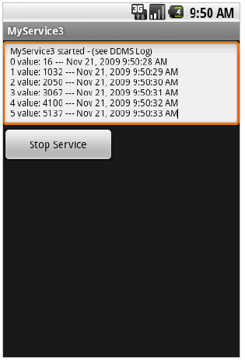
Example 2. cont’d - Layout
<?xml version="1.0" encoding="utf-8"?>
<LinearLayout android:id="@+id/widget32" android:layout_width="fill_parent" android:layout_height="fill_parent" android:orientation="vertical"
xmlns:android="http://schemas.android.com/apk/res/android"
>
<EditText
android:id="@+id/txtMsg" android:layout_width="fill_parent" android:layout_height="120px" android:textSize="12sp"
>
</EditText>
<Button
android:id="@+id/btnStopService" android:layout_width="151px" android:layout_height="wrap_content" android:text="Stop Service"
>
</Button>
</LinearLayout>
Page 45 Fall 2011 CS 495/595 - App Development for Smart Device
s

Slide 28
Example 2. cont’d - Manifest
<?xml version="1.0" encoding="utf-8"?>
<manifest xmlns:android="http://schemas.android.com/apk/res/android" package="cis493.demos“
android:versionCode="1“ android:versionName="1.0.0">
<uses-sdkandroid:minSdkVersion="4"></uses-sdk>
<application android:icon="@drawable/icon“ android:label="@string/app_name">
<activity android:name=".MyServiceDriver“ android:label="@string/app_name">
<intent-filter>
<action android:name="android.intent.action.MAIN" />
<category android:name="android.intent.category.LAUNCHER" />
</intent-filter>
</activity>
<service android:name="MyService">
</service>
</application>
</manifest>

Slide 29
Example 2. cont’d – Main Activity
// Application logic and its BroadcastReceiver in the same class
package cs495.demos; import java.util.Date;
import android.app.Activity;
import android.content.BroadcastReceiver; import android.content.ComponentName; import android.content.Context;
import android.content.Intent; import android.content.IntentFilter; import android.os.Bundle;
import android.os.SystemClock;
import android.util.Log;
import android.view.View;
import android.view.View.OnClickListener; import android.widget.*;
public class MyServiceDriver extends Activity {
TextView txtMsg;
Button btnStopService; Component Nameservice; Intent intentMyService; BroadcastReceiver receiver;

Slide 30
Example 2. cont’d – Main Activity
@Override
public void onCreate(Bundle savedInstanceState){ super.onCreate(savedInstanceState); setContentView(R.layout.main);
txtMsg= (TextView) findViewById(R.id.txtMsg);
intentMyService= new Intent(this, MyService.class);
service= startService(intentMyService);
txtMsg.setText("MyService started -(see DDMS Log)"); btnStopService= (Button) findViewById(R.id.btnStopService); btnStopService.setOnClickListener(new OnClickListener() {
public void onClick(View v) { try{
stopService(new Intent(intentMyService) );
txtMsg.setText("After stopingService: \n"+ service.getClassName());
} catch(Exception e) {
e.printStackTrace();
}
}
});

Slide 31
Example 2. cont’d – Main Activity
// register & define filter for local listener
IntentFilter mainFilter= new IntentFilter("cs495.action.DEMO2"); receiver= new MyMainLocalReceiver(); registerReceiver(receiver, mainFilter);
} //onCreate
register
//////////////////////////////////////////////////////////////////////// @Override
protected void onDestroy() { super.onDestroy();
try {
stopService(intentMyService);
unregisterReceiver(receiver);
} catch (Exception e) {
Log.e("MAIN-DESTROY>>>", e.getMessage() );
}
Log.e("MAIN-DESTROY>>>", "Adios");
} //onDestroy
unregister

Slide 32
Example 2. cont’d – Main Activity
//////////////////////////////////////////////////////////////////////
// local (embedded) RECEIVER
public class MyMainLocalReceiver extends BroadcastReceiver{
@Override
public void onReceive(Context localContext, Intent callerIntent) {
Get data
String serviceData= callerIntent.getStringExtra("serviceData"); Log.e("MAIN>>>", serviceData+ " -receiving data "
+ SystemClock.elapsedRealtime() );
String now = "\n"+ serviceData+ " ---"
+ new Date().toLocaleString();
txtMsg.append(now);
}
} //MyMainLocalReceiver
} //MyServiceDriver

Slide 33
Example 2. cont’d – The Service
// Service uses a thread to run slow operation
package cs495.demos;
import android.app.Service; import android.content.Intent; import android.os.IBinder; import android.util.Log;
public class MyService extendsService { boolean isRunning= true;
@Override
public IBinder onBind(Intent arg0) { return null;
}
@Override
public void onCreate() {
super.onCreate();
}

Slide 34
Example 2. cont’d – The Service
@Override
public void onStart(Intent intent, int startId) { super.onStart(intent, startId); Log.e("<<MyService-onStart>>", "I am alive!");
// we place the slow work of the service in its own thread
// so the caller is not hung up waiting for us
Thread triggerService= new Thread (new Runnable() { long startingTime= System.currentTimeMillis(); long tics= 0;
public void run() {
for (int i=0; (i< 120) & isRunning; i++) { //at most 10 minutes try {
//fake that you are very busy here
tics= System.currentTimeMillis() -startingTime;
Intent myFilteredResponse= new Intent("cs495.action.DEMO2");
String msg= i+ " value: "+ tics;
myFilteredResponse.putExtra("serviceData", msg);
sendBroadcast(myFilteredResponse);
Thread.sleep(1000); //five seconds
} catch(Exception e) { e.printStackTrace(); }
} //for
} //run
});
triggerService.start();
} //onStart
Set filter
broadcasting

Slide 35
Example 2. cont’d – The Service
@Override
public void onDestroy() { super.onDestroy();
Log.e("<<MyService-onDestroy>>", "I am dead");
isRunning= false;
Stop thread
} //onDestroy
} //MyService

Slide 36
Intent services
Three of the core components of an application are:
- Activities
- Services
- Broadcast Receivers
- They are activated through messages, called intents. Intent messaging is a facility for late run-time binding between components in the same or different applications.
- An Intent object, is a passive data structure holding an abstract description of an operation to be performed — or, often in the case of broadcasts, a description of something that has happened and is being announced.

Slide 37
Intent services
An Intent object is passed to Context.startActivity() or Activity.startActivityForResult() to launch an activity or get an existing activity to do something new.
(It can also be passed to Activity.setResult() to return information to the activity that called startActivityForResult().)
An Intent object is passed to Context.startService() to initiate a service or deliver new instructions to an ongoing service.
An intent can be passed to Context.bindService() to establish a connection between the calling component and a target service.
It can optionally initiate the service if it's not already running.

Slide 38
Intent services
Intent objects passed to any of the broadcast methods (such as Context.sendBroadcast(), Context.sendOrderedBroadcast(), or Context.sendStickyBroadcast())
are delivered to all interested broadcast receivers. Many kinds of broadcasts originate in system code.
- Intent are really useful with Android Service to exchange information and notification between the calling object and the Service.

Slide 39
Intent services
To inform the system which implicit intents they can handle, activities, services, and broadcast receivers can have one or more intent filters.
Each filter describes a capability of the component, a set of intents that the component is willing to receive.
, in effect, filters in intents of a desired type, while filtering out unwanted intents — but only unwanted implicit intents (those that don't name a target class).

Slide 40
Intent services
An explicit intent is always delivered to its target, no matter what it contains; the filter is not consulted..
An implicit intent is delivered to a component only if it can pass through one of the component's filters.
An intent filter is an instance of the IntentFilter class.
Android system must know about the capabilities of a component before it can launch that component, intent filters are generally not set up in Java code, but in the application's manifest file (AndroidManifest.xml) as <intent-filter> elements.

Slide 41
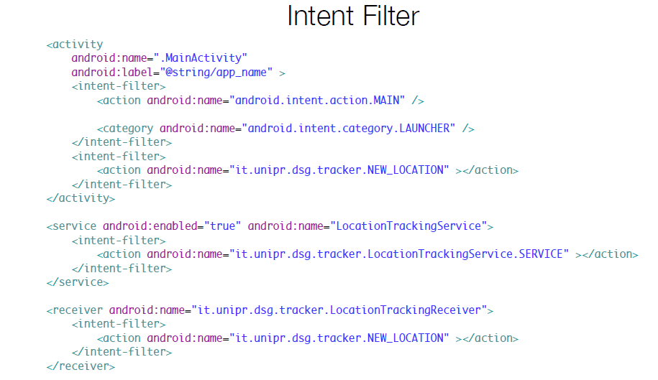
Intent services

Slide 42
MultiThreading: Handlers
MultiThreading is an ability of the operating system to run different parts of a program simultaneously.
These processes do not interfere with each other (in a well written program or application) and each is referred to as a thread.
In Android, multithreading is implemented through the Handler class.
Multithreading uses your system resources efficiently to get a task done. It also allows the operating system to juggle several tasks at the same time.

Slide 43
MultiThreading: Handlers
When a user opens an application, Android creates its own Linux process. The system creates a thread of execution for that application called the main thread or UI thread.
The main thread is nothing but a handler thread.
The main thread is responsible for handling events from all over the app like callbacks associated with the lifecycle information or callbacks from input events or handling events from other apps, etc

Slide 44
The Handler Class
In Android, multithreading is implemented through the Handler class.
The handler class lets you process and send message objects, which contain descriptions and data, and runnable objects that refer to a MessageQueue belonging to a thread.
A handler will let you execute message objects and runnable objects at a specified time in the future.

Slide 45
The Handler Class
Each instance of a handler will belong to a single thread only when declared.
Runnable objects are those objects that contain commands that will be executed to obtain results in your program.
A handler be used to execute a thread.
It will also allow various threads that make up a program to communicate with each other to prevent conflicts.

Slide 46
The Handler Class
A handler class can be implemented through the default constructor
Handler handlerObject = new Handler();
Handler handleObject = new Handler(Runnable runnableObject, Handler.Callback callbackObject);

Slide 47
The Handler Class : Example
import android.app.Activity;
import android.os.Bundle;
import android.os.Handler;
import android.widget.Button;
import android.widget.TextView;
Public class HandlerExample extends Activity {
Handler examhand = new Handler () ;
Button mybutton;
Textview mytextview;
Runnable run = new Runnable ()
{
@override
public void run()
{
//link to button click }
}

Slide 48
Methods a Handler Class used for Multithreading
public void dispatchMessage (Message msg) : System messages here
public Handler (): This will associate a handler instance with the looper for the thread. The thread must contain a looper for this to work. A looper is the class that is used to provide the message loop functionality to a thread.
public Handler (Looper nameofyourlooper): You can use another looper, instead of the default looper, by specifying it with this method.

Slide 49
Methods a Handler Class used for Multithreading
public Handler (Looper nameofyourlooper, Handler.Callback nameofyourcallback): This method, in addition to letting you assign a new looper, will let you use a callback interface to handle messages.
public final boolean post (Runnable r): This will cause the Runnable object r to the be added to the MessageQueue. The handler this method is implemented in will decide which thread the runnable object goes to.
public final void removeCallbacks (Runnable r): Any pending callbacks in the MessageQueue can be removed with this method.

Slide 50
Asynchronous Task (AsyncTask) in Android
AsyncTask
One of the most important problems in Android development is the User Interface (UI) responsiveness. Part of this is the fault of Android implementation, but much faults lies on the developer.
A key to a good GUI performance in Android development is to move as much work as possible off from the UI thread into the background. Using AsyncTasks is one of the easiest way to do this.

Slide 51
Asynchronous Task (AsyncTask) in Android
AsyncTask
An Android application operates in a single thread. Due to this single-thread approach, tasks that take a long time to fetch a response may cause the program to become unresponsive.
We use Android AsyncTask to perform these heavy tasks in the background on a separate thread and return the results back to the UI thread in order to prevent this.
As a result, the UI thread is always responsive when AsyncTask is used in an Android application.

Slide 52
Asynchronous Task (AsyncTask) in Android
When to use AsyncTask?
An AsyncTask is designed to be a helper class around threads and handlers.
As described in the Android documentation:
“AsyncTask enables proper and easy use of the UI thread. This class allows to perform background operations and publish results on the UI thread without having to manipulate threads and/or handlers.”

Slide 53
Asynchronous Task (AsyncTask) in Android
Simply said: An AsyncTask is used to do some computation in background and publish the result on the UI thread
AsyncTasks ideally are designed to perform operations in background which take at most a few seconds.
It is not recommended to use them for downloading megabytes of data from servers or doing CPU intensive tasks, such as image processing.

Slide 54
Asynchronous Task (AsyncTask) in Android
If you want to keep threads running for a long period of time, it is strongly recommended to use Java threads or classes such as java.util.concurrent.Executor or java.util.concurrent.ThreadPoolExecutor in combination with android.os.Handler to publish the results on the UI thread.
Note : If you need to do network operations using either Java threads or AsyncTask. In Android 4 and above attempting to access the network from the UI thread will throw an exception.

Slide 55
Asynchronous Task (AsyncTask) in Android
Asynchronous tasks are divided into three generic types: Params, Progress, & Result
Params: Parameters sent to the task upon execution
Progress: Progress units shared during the background computation
Result: Result obtained from the background computation

Slide 56
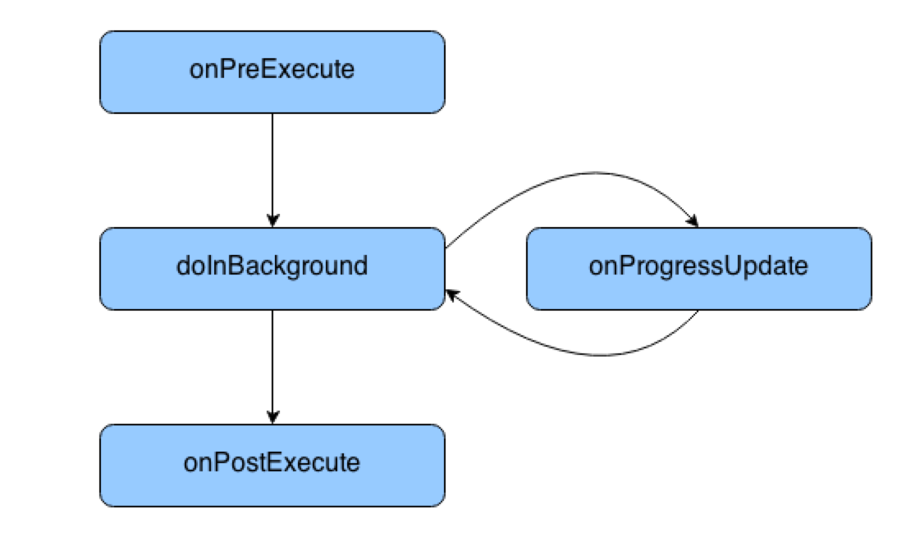
Asynchronous Task (AsyncTask) in Android
AsyncTask – Life Cycle

Slide 57
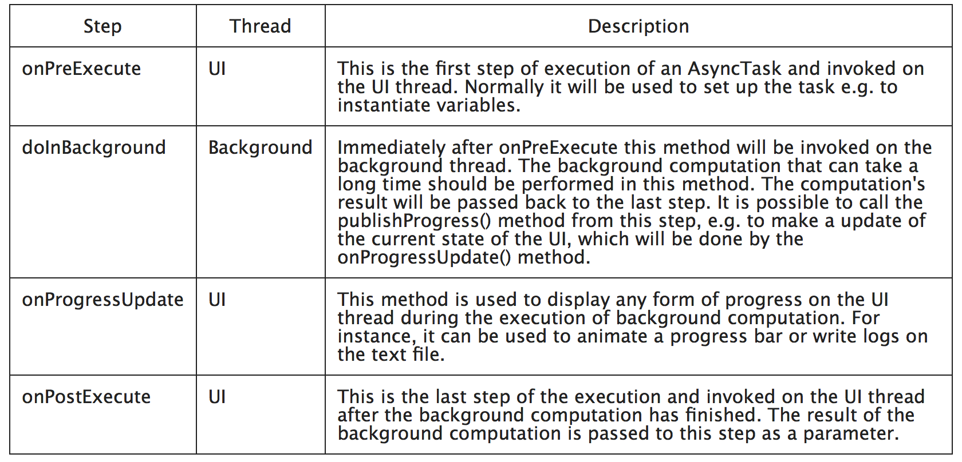
Asynchronous Task (AsyncTask) in Android
AsyncTask – Life Cycle

Slide 58
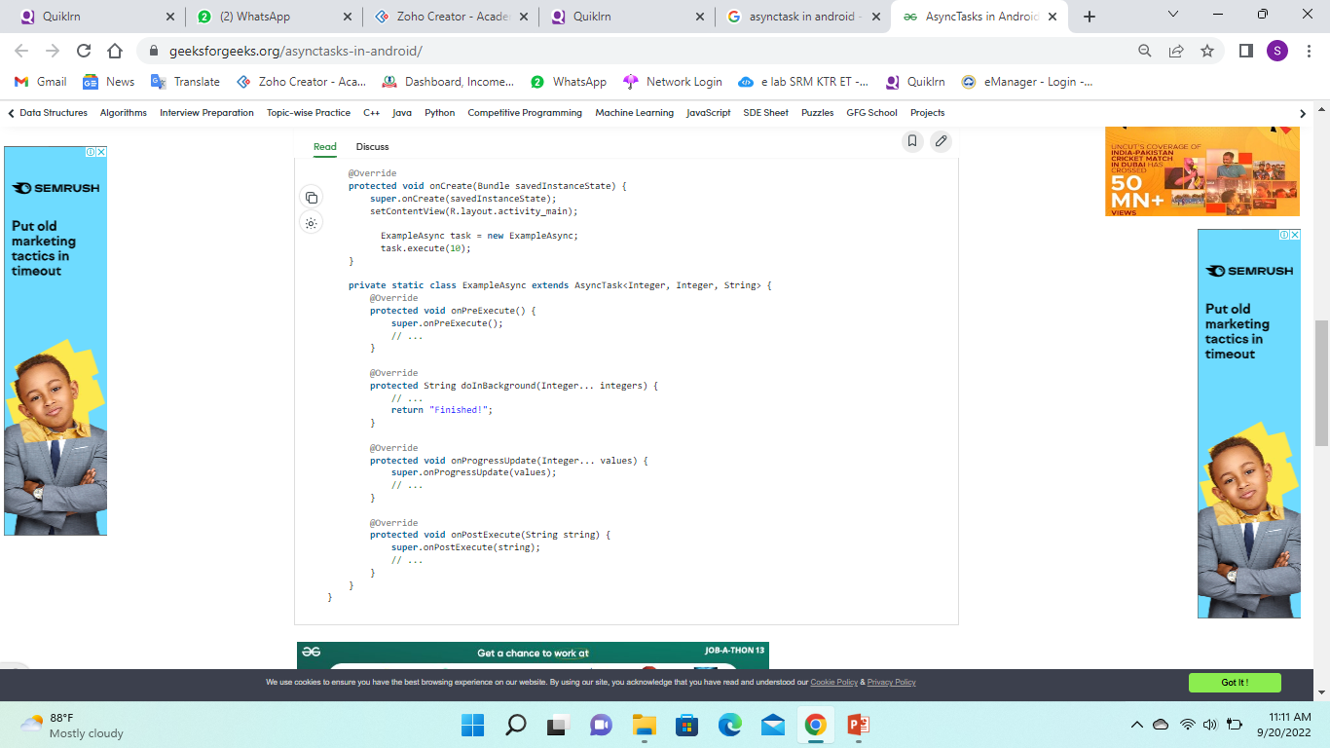
Asynchronous Task (AsyncTask) in Android
public class MainActivity extends AppCompatActivity
{
@Override
protected void onCreate(Bundle savedInstanceState) {
super.onCreate(savedInstanceState);
setContentView(R.layout.activity_main);
ExampleAsync task = new ExampleAsync;
task.execute(10);
}
private static class ExampleAsync extends AsyncTask<Integer, Integer, String> {
@Override
protected void onPreExecute() {
super.onPreExecute();
// ...
}
@Override
protected String doInBackground(Integer... integers) {
// ...
return "Finished!";
}
@Override
protected void onProgressUpdate(Integer... values) {
super.onProgressUpdate(values);
// ...
}
@Override
protected void onPostExecute(String string) {
super.onPostExecute(string);
// ...
}
}
}

Slide 59
Asynchronous Task (AsyncTask) in Android
public class MainActivity extends AppCompatActivity
{
@Override
protected void onCreate(Bundle savedInstanceState) {
super.onCreate(savedInstanceState);
setContentView(R.layout.activity_main);
ExampleAsync task = new ExampleAsync;
task.execute(10);
}
private static class ExampleAsync extends AsyncTask<Integer, Integer, String> {
@Override
protected void onPreExecute() {
super.onPreExecute();
// ...
}
@Override
protected String doInBackground(Integer... integers) {
// ...
return "Finished!";
}
@Override
protected void onProgressUpdate(Integer... values) {
super.onProgressUpdate(values);
// ...
}
@Override
protected void onPostExecute(String string) {
super.onPostExecute(string);
// ...
}
}
}

Slide 60
Asynchronous Task (AsyncTask) in Android
To use AsyncTask you must subclass it. An AsyncTask is started via the execute() method.
The execute() method calls the doInBackground() method.
AsyncTask is an intelligent thread that is recommended to be used. It is intelligent as it can help with it’s methods, and there are two methods that run on the UI thread, which is good to update UI components.

Slide 61
Asynchronous Task (AsyncTask) in Android
Use AsyncTask for:
Simple network operations which do not require downloading a lot of data
Disk-bound tasks that might take less than a few milliseconds

Slide 62
android network programming: HttpUrlConnection
Android lets your application connect to the internet or any other local network and allows you to perform network operations.
A device can have various types of network connections. This chapter focuses on using either a Wi-Fi or a mobile network connection.

Slide 63
android network programming: HttpUrlConnection
Checking Network Connection
Before you perform any network operations, you must first check that are you connected to that network or internet e.t.c. For this android provides ConnectivityManager class. You need to instantiate an object of this class by calling getSystemService() method.
Its syntax is given below −
ConnectivityManager check = (ConnectivityManager)
this.context.getSystemService(Context.CONNECTIVITY_SERVICE);

Slide 64
android network programming: HttpUrlConnection
Checking Network Connection
Once you instantiate the object of ConnectivityManager class, you can use getAllNetworkInfo method to get the information of all the networks. This method returns an array of NetworkInfo. So you have to receive it like this.
NetworkInfo[] info = check.getAllNetworkInfo();

Slide 65
android network programming: HttpUrlConnection
Checking Network Connection
to check Connected State of the network,
syntax is given below −
for (int i = 0; i<info.length; i++){
if (info[i].getState() == NetworkInfo.State.CONNECTED){
Toast.makeText(context, "Internet is connected
Toast.LENGTH_SHORT).show();
}
}

Slide 66
android network programming: HttpUrlConnection
Performing Network Operations
Android provides HttpURLConnection and URL class to handle these operations. You need to instantiate an object of URL class by providing the link of website.
Its syntax is
String link = "http://www.google.com";
URL url = new URL(link);

Slide 67
android network programming: HttpUrlConnection
Performing Network Operations
After that you need to call openConnection method of url class and receive it in a HttpURLConnection object. After that you need to call the connect method of HttpURLConnection class.
HttpURLConnection conn = (HttpURLConnection) url.openConnection();
conn.connect();

Slide 68
android network programming: HttpUrlConnection
Performing Network Operations
Finally we need to fetch the HTML from the website. For this you will use InputStream and BufferedReader class.
Its syntax is .
InputStream is = conn.getInputStream();
BufferedReader reader = new BufferedReader(new InputStreamReader(is, "UTF-8"));
String webPage = "", data="";
while ((data = reader.readLine()) != null){
webPage += data + "\n";
}

Slide 69
android network programming: HttpUrlConnection
Performing Network Operations
Apart from this connect method, there are other methods available in HttpURLConnection class.
They are
Sr.No | Method & description
1 | disconnect() This method releases this connection so that its resources may be either reused or closed
2 | getRequestMethod() This method returns the request method which will be used to make the request to the remote HTTP server
3 | getResponseCode() This method returns response code returned by the remote HTTP server

Slide 70
android network programming: HttpUrlConnection
Performing Network Operations
Apart from this connect method, there are other methods available in HttpURLConnection class.
They are
Sr.No | Method & description
4 | setRequestMethod(String method) This method Sets the request command which will be sent to the remote HTTP server
5 | usingProxy() This method returns whether this connection uses a proxy server or not

Slide 71
android network programming: HttpUrlConnection
Code Example
https://www.tutorialspoint.com/android/android_network_connection.htm

Slide 72
Connecting to REST-based and SOAP based Web services
Web services are XML-based information exchange systems that use the Internet for direct application-to-application interaction.
A WebService is a Consumer_Machine-to-Provider_Machine collaboration schema that operates over a computer network.
The data exchanges occur independently of the OS, browser, platform, and programming languages used by the provider and the consumers.

Slide 73
Connecting to REST-based and SOAP based Web services
A provider may expose multiple EndPoints (sets of WebServices), each offering any number of typically related functions.
WebServices expect the computer network to support standard Web protocols such as XML, HTTP, HTTPS, FTP, and SMTP.
Example: Weather information, money exchange rates, world news, stock market quotation are examples of applications that can be modeled around the notion of a remote data-services provider surrounded by countless consumers tapping on the server’s resources.

Slide 74
Connecting to REST-based and SOAP based Web services
Under the WebService strategy the invoked functions are implemented once (in the server) and called many times (by the remote users).
Some advantages are:
Elimination of redundant code,
Ability to transparently make changes on the server to update a particular service function without clients having to be informed.
Reduced maintenance and production costs.

Slide 75
Connecting to REST-based and SOAP based Web services
WebService Architecture
An ideal Webservice provider is designed around four logical layers which define the ways in which data is to be transported, encoded, exposed and discovered by the users.
Layers | Responsibility
Transport | Move messages through the network, using HTTP, SMTP, FTP, …
Messaging | Encoding of data to be exchanged (XML)
Description | WSDL (Web Service Desc. Lang) used for describing public methods available from the endpoint
Discovery | UDDI (Universal Description & Discovery Integration) facilitates location and publishing of services through a common registry

Slide 76
Connecting to REST-based and SOAP based Web services
The Client Side - Consuming WebServices
There are two widely used forms of invoking and consuming WebServices:
Representational State Transfer (REST)
Remote Procedure Call (RPC).

Slide 77
Connecting to REST-based and SOAP based Web services
Representational State Transfer (REST)
Closely tie to the HTTP protocol by associating its operation to the common methods: GET, POST, PUT, DELETE for HTTP/HTTPS.
This model has a simple invocation mode and little overhead. Service calls rely on a URL which may also carry arguments.
Sender & receiver must have an understanding of how they pass data items from one another.
As an example: Google Maps API uses the REST model.

Slide 78
Connecting to REST-based and SOAP based Web services
Remote Procedure Call (RPC).
Remote services are seen as coherent collections of discoverable functions (or method calls) stored and exposed by EndPoint providers.
Implementations of this category are: Simple Object Access Protocol (SOAP), Common Object Request Broker Architecture (CORBA), Microsoft's Distributed Component Object Model (DCOM) and Sun Microsystems's Java/Remote Method Invocation (RMI).

Slide 79
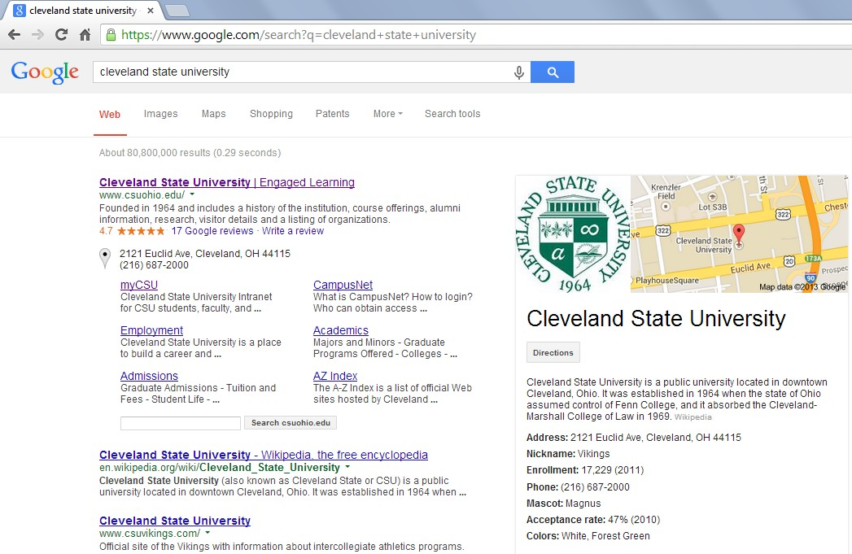
Connecting to REST-based and SOAP based Web services
Example: Using REST.
The following URL is used to make a call to the Google Search service asking to provide links to the subject “Cleveland State University”
Transport Provider
Action
Arguments
https://www.google.com/search?q=cleveland+state+university
Figure 1. Example of a REST web-service called with a URL that includes arguments

Slide 80
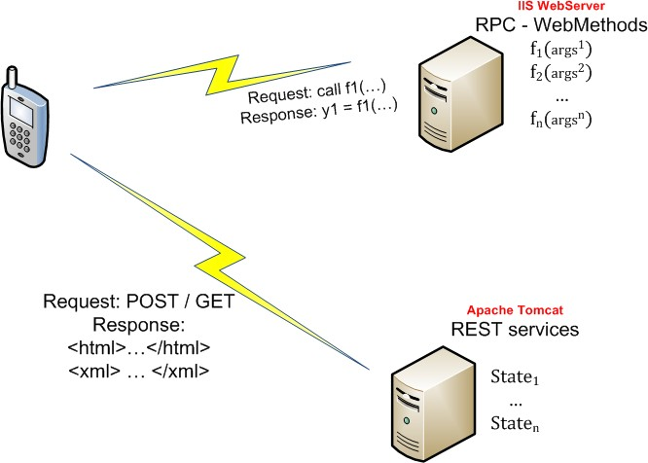
Connecting to REST-based and SOAP based Web services
A WebClient consuming services using REST & SOAP
SOAP
Request: XML envelope holding function-name, arguments.
Response: XML formatted results
Android Web-Client
REST
Using common URL
Request
http://provider.org?op=function&
arg1=val1& arg2=val2
Response Free format. Options include: Plain-text, HTML, XML, JSON…

Slide 81
Connecting to REST-based and SOAP based Web services
Three examples of Android web-client typically interacts with a remote server requesting and consuming WebServices.
Example 1. SOAP client / .NET provider
An Android app uses a XML KSOAP envelope to call a Windows IIS server. WebServices are implemented as a set of C#.NET functions.
Example 2. REST client / PHP provider
A REST Android client invokes remote PHP services which consult a database on behalf of the client. The response is formatted using JSON.
Example 3. REST client / Servlet provider
Our Android app communicates with an Tomcat Server in which its WebServices are implemented as Java Servlets. As in the previous example, the results of a database query are returned as a JSON string.

Slide 82
Connecting to REST-based and SOAP based Web services
Windows Communication Foundation (WCF)
WCF is a Microsoft technology that provides a framework for writing code to communicate across heterogeneous platforms.
An IIS WebServer may host various EndPoints (WebServices).
Each of those EndPoints uses WSDL to provide a way of exposing its composition and behavior to clients wishing to find and communicate with the services.
Each endpoint includes:
address (URL - where to send messages),
binding (how to send messages ), and a
contract (an explanation of what messages contain)

Slide 83
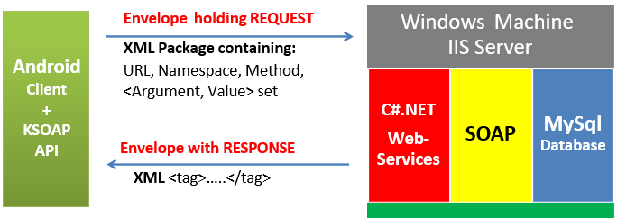
Connecting to REST-based and SOAP based Web services
Example1: Android SOAP Web-Client & .NET WebServices
WCF is a Microsoft technology that provides a framework for writing code to communicate across heterogeneous platforms.

Slide 84
Connecting to REST-based and SOAP based Web services
Example1: KSOAP API
The ksoap2-android project provides a lightweight and efficient SOAP client library for the Android platform.
Android does not supply a native mechanism to handle SOAP exchanges
KSOAP is designed for limited hardware devices.
KSOAP can exchange simple Java types (SoapPrimitive), as well as serialized complex objects (SoapObject).

Slide 85
Connecting to REST-based and SOAP based Web services
For more details

Slide 86
BroadcastReceivers
Component that responds to system-wide broadcast announcements.
Example system broadcasts: screen has turned off, the battery is low, user is present using phone, or a picture was captured.
Applications can initiate broadcasts—e.g., to let other applications know that some data has been downloaded to the device and is available for them to use.
Don’t display a UI, but can create a status bar notification to alert the user when a broadcast event occurs.

Slide 87
BroadcastReceivers
Usually, a broadcast receiver is just a "gateway" to other components and is intended to do a very minimal amount of work. For instance, it might initiate a service to perform some work based on the event.
Important: you must complete tasks in a BroadcastReceiver in <10s. If you have a task that will take longer, you must start a new thread to avoid app assassin OS.

Slide 88
BroadcastReceivers
Usually, a broadcast receiver is just a "gateway" to other components and is intended to do a very minimal amount of work. For instance, it might initiate a service to perform some work based on the event.
Important: you must complete tasks in a BroadcastReceiver in <10s. If you have a task that will take longer, you must start a new thread to avoid app assassin OS..

Slide 89
BroadcastReceiver Lifecycle
The system delivers a broadcast Intent to all interested broadcast receivers, which handle the Intent sequentially.

Slide 90
BroadcastReceiver Lifecycle
A broadcast receiver has a single callback method:
void onReceive(ContextcurContext, IntentbroadcastMsg)
1.When a broadcast message arrives for the receiver, Android calls its onReceive() method and passes it the Intent object containing the message.
2.The broadcast receiver is considered to be active only while it is executing this method.
3.When onReceive() returns, it is inactive.

Slide 91
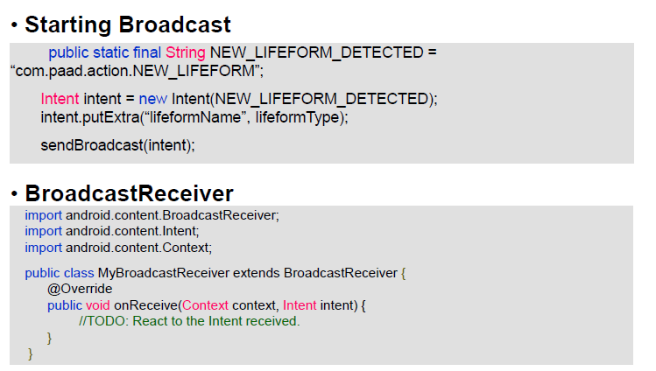
BroadcastReceiver Lifecycle
A broadcast receiver has a single callback method:
void onReceive(ContextcurContext, IntentbroadcastMsg)
1.When a broadcast message arrives for the receiver, Android calls its onReceive() method and passes it the Intent object containing the message.
2.The broadcast receiver is considered to be active only while it is executing this method.
3.When onReceive() returns, it is inactive.

Slide 92
BroadcastReceiver Lifecycle
Manifest File
The manifest of applications using Android Services must include:
1.A <service> entry for each service used in the application.
2.If the application defines a BroadcastReceiver as an independent class, it must include a <receiver> clause identifying the component.
In addition an <intent-filter> entry is needed to declare the actual filter the service and the receiver use.

Slide 93
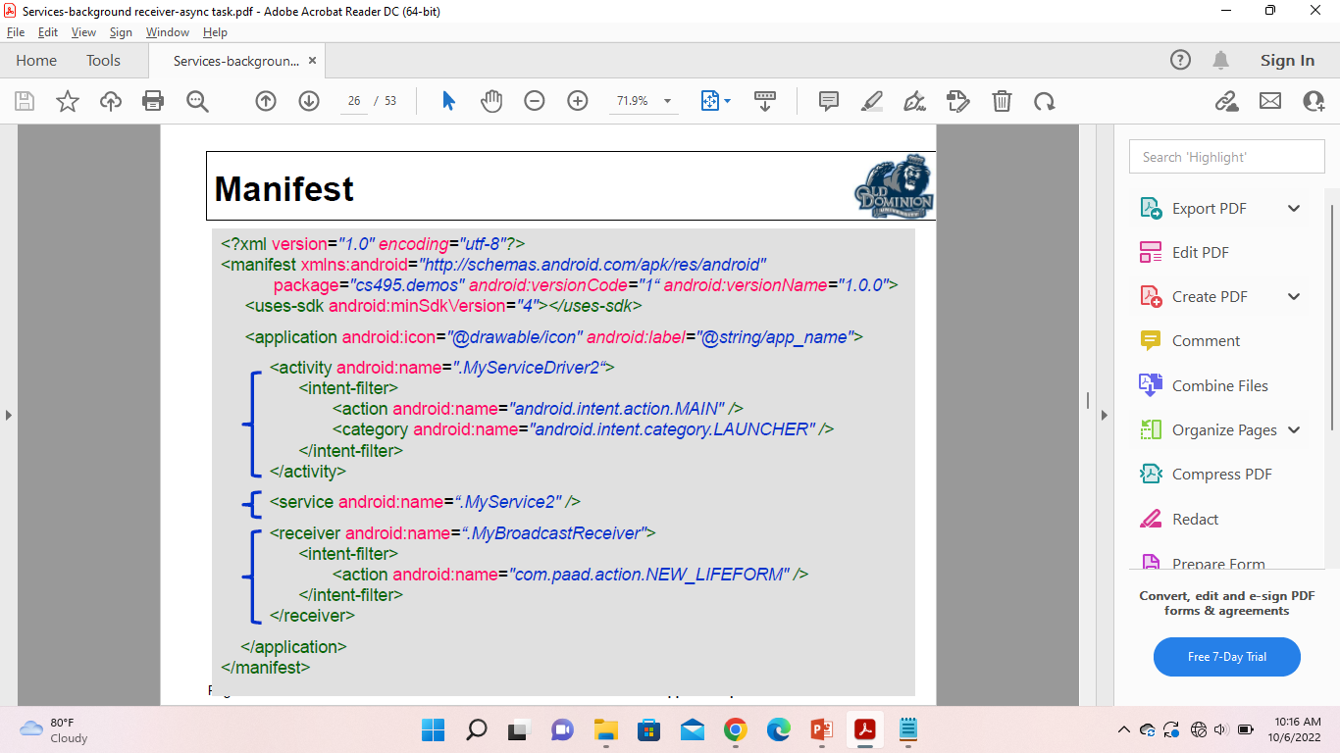
BroadcastReceiver Lifecycle
Manifest File
The manifest of applications using Android Services must include:
1.A <service> entry for each service used in the application.
2.If the application defines a BroadcastReceiver as an independent class, it must include a <receiver> clause identifying the component. In addition an <intent-filter> entry is needed to declare the actual filter the service and the receiver use.

Slide 94
BroadcastReceiver : Native Broadcasts
ACTION_BOOT_COMPLETED
ACTION_CAMERA_BUTTON
ACTION_DATE_CHANGED and ACTION_TIME_CHANGED
ACTION_MEDIA_BUTTON
ACTION_MEDIA_EJECT
ACTION_MEDIA_MOUNTED
ACTION_MEDIA_UNMOUNTED
ACTION_SCREEN_OFF and ACTION_SCREEN_ON
ACTION_TIMEZONE_CHANGED

Slide 95
BroadcastReceiver : Native Broadcasts
Local Broadcast Manager is one of the most important features which is seen in most of the applications which we used.
This feature generally works in the background and we cant see that.
The BroadCast Manager will notify us when a specific event occurs.
For example when we are subscribed to any of the courses on online when there is an update or contest being conducted in that course then we are notified through email regarding that event.
In that place, BroadCast Manager is used which notifies users with a message, mail, or any other format regarding a specific event. In this article, we will take a look at using this Broadcast Manager in our Android App.

Slide 96
BroadcastReceiver : Native Broadcasts
Using Broad Cast Manager in Android
Step 1: Registering a Broadcast
For performing a specific action using Broadcast manager we have to firstly register our Broadcast and then only we can use this broadcast to receive updates. There are 2 ways to register our broadcast we can register it in our Android Manifest file or in our Activity where we want to receive its updates.
Step 2: Receiving the updates from Broadcast
This step is used to receive the updates which we will send through our Broadcast Manager after performing a certain action inside our application. For receiving the updates we will be using onReceive() method to receive the update.

Slide 97
BroadcastReceiver : Native Broadcasts
import android.content.BroadcastReceiver;
import android.content.Context;
import android.content.Intent;
import android.content.IntentFilter;
import androidx.appcompat.app.AppCompatActivity;
import androidx.localbroadcastmanager.content.LocalBroadcastManager;
public class MainActivity extends AppCompatActivity {
// creating a variable for
// our text view and button
private TextView headingTV;
private Button sendBroadCastBtn;
// on below line we are creating a new broad cast manager.
private BroadcastReceiver broadcastReceiver = new BroadcastReceiver() {
// we will receive data updates in onReceive method.
@Override
public void onReceive(Context context, Intent intent) {
// Get extra data included in the Intent
String message = intent.getStringExtra("message");
// on below line we are updating the data in our text view.
headingTV.setText(message);
}
};

Slide 98
BroadcastReceiver : Native Broadcasts
protected void onCreate(Bundle savedInstanceState) {
super.onCreate(savedInstanceState);
setContentView(R.layout.activity_main);
// initializing our variables.
headingTV = findViewById(R.id.idTVHeading);
sendBroadCastBtn = findViewById(R.id.idBtnStartBroadCast);
// on below line we are registering our local broadcast manager.
LocalBroadcastManager.getInstance(this).registerReceiver(broadcastReceiver, new IntentFilter("custom-action-local-broadcast"));
// on below line we are adding click listener to our button
sendBroadCastBtn.setOnClickListener(new View.OnClickListener() {
@Override
public void onClick(View v) {
// inside on click we are calling the intent with the action.
Intent intent = new Intent("custom-action-local-broadcast");
// on below line we are passing data to our broad cast receiver with key and value pair.
intent.putExtra("message", "Welcome \n to \n Geeks For Geeks");
// on below line we are sending our broad cast with intent using broad cast manager.
LocalBroadcastManager.getInstance(MainActivity.this).sendBroadcast(intent);
}
});
}
}

Slide 99
Dynamic broadcast receivers in Android
The dynamic receivers will run if the application is running.
Suppose we have a normal broadcast receiver registered for BATTERY_LOW and we are doing some urgent work on the mobile phone and its battery is very low so we closed all the applications which are currently running.
And then the Android os will send the battery low broadcast to all the receivers this will be received in our application and the system will start our application for handling this broadcast, here we are doing some urgent work and the starting of the application will annoy the user.
In these situations, we are using a dynamic receiver which will check whether our application is running currently then only it will show.
For creating a dynamic receiver we don't need to add the receiver in the manifest file. We need to create this through the java code.

Slide 100
Dynamic broadcast receivers in Android
intentFilter = new IntentFilter();
intentFilter.addAction("tutorial.negociosit.com.tutorial6.TEST_BROADCAST");
//Create a broadcast listener in the java class.
private BroadcastReceiver broadcastReceiver = new BroadcastReceiver() {
@Override
public void onReceive(Context context, Intent intent) {
Toast.makeText(context,"This is the broadcast",Toast.LENGTH_SHORT).show();
}
};
registerButton.setOnClickListener(new View.OnClickListener() {
@Override
public void onClick(View view) {
registerReceiver(broadcastReceiver,intentFilter);
}
});

Slide 101
Dynamic broadcast receivers in Android
sendButton.setOnClickListener(new View.OnClickListener() {
@Override
public void onClick(View view) {
Intent intent = new Intent();
intent.setAction("tutorial.negociosit.com.tutorial6.TEST_BROADCAST");
sendBroadcast(intent);
}
});

Slide 102
Pending Intent
A pending intent is a token that you give to another application. For example, the notification manager, alarm manager or other 3rd party applications). This allows the other application to restore the permissions of your application to execute a predefined piece of code.
To perform a broadcast via a pending intent, get a PendingIntent via the getBroadcast() method of the PendingIntent class.
To perform an activity via a pending intent, you receive the activity via PendingIntent.getActivity().

Slide 103
System broadcasts
Several system events are defined as final static fields in the Intent class. Other Android system classes also define events, e.g., the TelephonyManager defines events for the change of the phone state.
Event | Description
Intent.ACTION_BOOT_COMPLETED | Boot completed. Requires the android.permission.RECEIVE_BOOT_COMPLETED permission
Intent.ACTION_POWER_CONNECTED | Power got connected to the device.
Intent.ACTION_POWER_DISCONNECTED | Power got disconnected to the device.
Intent.ACTION_BATTERY_LOW | Triggered on low battery. Typically used to reduce activities in your app which consume power.
Intent.ACTION_BATTERY_OKAY | Battery status good again.

Slide 104
Telephony Manager
TelephonyManager class provides information about the telephony services such as subscriber id, sim serial number, phone network type etc. Moreover, you can determine the phone state etc.

Slide 105
Telephony Manager
Access to the telephony APIs is managed by the Telephony Manager
String srvcName = Context.TELEPHONY_SERVICE; TelephonyManager telephonyManager = (TelephonyManager)getSystemService(srvcName);
Using Telephony Manager we can obtain: ➤ the phone type (GSM or CDMA), ➤ unique ID (IMEI or MEID), ➤ software version, ➤ number.
Requires the READ_PHONE_STATE uses-permission be included in the application manifest.
<uses-permission android:name="android.permission.READ_PHONE_STATE"/>

Slide 106
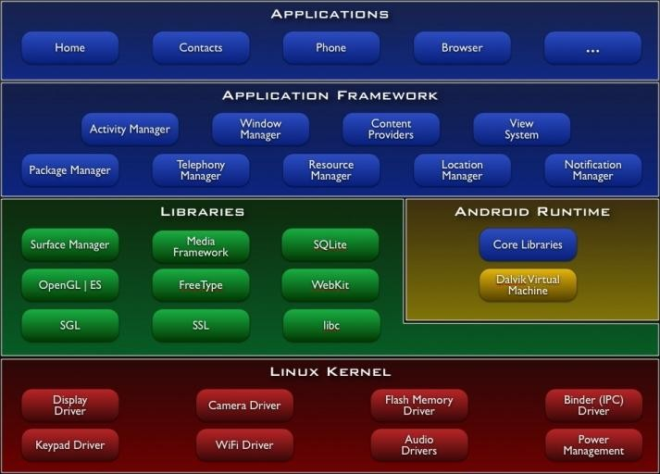

Telephony Manager
Access to the telephony APIs is managed by the Telephony Manager
String srvcName = Context.TELEPHONY_SERVICE; TelephonyManager telephonyManager = (TelephonyManager)getSystemService(srvcName);
Thru Telephony Manager you can obtain: ➤ the phone type (GSM or CDMA), ➤ unique ID (IMEI or MEID), ➤ software version, ➤ number.
Requires the READ_PHONE_STATE uses-permission be included in the application manifest.
<uses-permission android:name="android.permission.READ_PHONE_STATE"/>

Slide 107
Reading Phone Details
// Read the phone’s type
int phoneType = telephonyManager.getPhoneType(); switch (phoneType) {
case (TelephonyManager.PHONE_TYPE_CDMA): //do something break;
case (TelephonyManager.PHONE_TYPE_GSM) : //do something break;
case (TelephonyManager.PHONE_TYPE_NONE): //do something break;
default:
break;
}
// -- These require READ_PHONE_STATE uses-permission --
// Read the IMEI for GSM or MEID for CDMA String deviceId = telephonyManager.getDeviceId();
// Read the software version on the phone (note -- not the SDK version)
String softwareVersion = telephonyManager.getDeviceSoftwareVersion();
// Get the phone’s number
String phoneNumber = telephonyManager.getLine1Number();

Slide 108
Reading Data Connection Status
int dataActivity = telephonyManager.getDataActivity(); int dataState = telephonyManager.getDataState(); switch (dataActivity) {
case TelephonyManager.DATA_ACTIVITY_IN: //Currently receiving IP PPP traffic.
break;
case TelephonyManager.DATA_ACTIVITY_OUT: //Currently sending IP PPP traffic.
break;
case TelephonyManager.DATA_ACTIVITY_INOUT: //Currently both IN & OUT
break;
case TelephonyManager.DATA_ACTIVITY_NONE: //No traffic.
break;
}
switch (dataState) {
case TelephonyManager.DATA_CONNECTED: //Connected.
break;
case TelephonyManager.DATA_CONNECTING: //Currently setting up data connection
break;
case TelephonyManager.DATA_DISCONNECTED: //Disconnected break;
case TelephonyManager.DATA_SUSPENDED: //Suspended
break;
}

Slide 109
Reading Network Details
// Get connected network country ISO code
String networkCountry = telephonyManager.getNetworkCountryIso();
// Get the connected network operator ID (MCC + MNC)
String networkOperatorId = telephonyManager.getNetworkOperator();
// Get the connected network operator name
String networkName = telephonyManager.getNetworkOperatorName();
// Get the type of network you are connected to
int networkType = telephonyManager.getNetworkType();
switch (networkType) {
case (TelephonyManager.NETWORK_TYPE_1xRTT): /* … */ break;
case (TelephonyManager.NETWORK_TYPE_CDMA) : /* … */ break;
case (TelephonyManager.NETWORK_TYPE_EDGE) : /* … */ break;
case (TelephonyManager.NETWORK_TYPE_EVDO_0) : /* … */ break;
case (TelephonyManager.NETWORK_TYPE_EVDO_A) : /* … */ break;
case (TelephonyManager.NETWORK_TYPE_GPRS) : /* … */ break;
case (TelephonyManager.NETWORK_TYPE_HSDPA) : /* … */ break;
case (TelephonyManager.NETWORK_TYPE_HSPA) : /* … */ break;
case (TelephonyManager.NETWORK_TYPE_HSUPA) : /* … */ break;
case (TelephonyManager.NETWORK_TYPE_UMTS) : /* … */ break;
case (TelephonyManager.NETWORK_TYPE_UNKNOWN): /* … */ break;
default: break;
}

Slide 110
Reading SIM Details
int simState = telephonyManager.getSimState(); switch (simState) {
case (TelephonyManager.SIM_STATE_ABSENT): break;
case (TelephonyManager.SIM_STATE_NETWORK_LOCKED): break; case (TelephonyManager.SIM_STATE_PIN_REQUIRED): break; case (TelephonyManager.SIM_STATE_PUK_REQUIRED): break; case (TelephonyManager.SIM_STATE_UNKNOWN): break;
case (TelephonyManager.SIM_STATE_READY): {
// Get the SIM country ISO code
String simCountry = telephonyManager.getSimCountryIso();
// Get the operator code of the active SIM (MCC + MNC)
String simOperatorCode = telephonyManager.getSimOperator();
// Get the name of the SIM operator
String simOperatorName = telephonyManager.getSimOperatorName();
// -- Requires READ_PHONE_STATE uses-permission --
// Get the SIM’s serial number
String simSerial = telephonyManager.getSimSerialNumber();
break;
}
default: break;
}

Slide 111
Monitoring Phone Status
Android lets you:
➤ monitor phone state,
➤ retrieve incoming phone numbers,
➤ observe changes to data connections, signal strength, and network
connectivity.
Must specify the READ_PHONE_STATE uses- permission in its manifest
Extend PhoneStateListener class to listen and respond to:
➤ Phone state change events including call state (ringing, off hook, etc.),
➤ Cell location changes,
➤ Voice-mail and call-forwarding status,
➤ Phone service changes,
➤ Changes in mobile signal strength.

Slide 112
Monitoring Phone Status
Phone State Listener skeleton class
PhoneStateListener phoneStateListener = new PhoneStateListener() { public void onCallForwardingIndicatorChanged(boolean cfi) {}
public void onCallStateChanged(int state, String incomingNumber) {} public void onCellLocationChanged(CellLocation location) {}
public void onDataActivity(int direction) {}
public void onDataConnectionStateChanged(int state) {}
public void onMessageWaitingIndicatorChanged(boolean mwi) {} public void onServiceStateChanged(ServiceState serviceState) {} public void onSignalStrengthChanged(int asu) {}
};
Registering a Phone State Listener
telephonyManager.listen(phoneStateListener, PhoneStateListener.LISTEN_CALL_FORWARDING_INDICATOR | PhoneStateListener.LISTEN_CALL_STATE | PhoneStateListener.LISTEN_CELL_LOCATION | PhoneStateListener.LISTEN_DATA_ACTIVITY | PhoneStateListener.LISTEN_DATA_CONNECTION_STATE | PhoneStateListener.LISTEN_MESSAGE_WAITING_INDICATOR | PhoneStateListener.LISTEN_SERVICE_STATE | PhoneStateListener.LISTEN_SIGNAL_STRENGTH);

Slide 113
Monitoring Phone Calls
The onCallStateChanged handler receives the phone number associated with incoming calls, and the state parameter represents the current call state:
➤ TelephonyManager.CALL_STATE_IDLE When the phone is neither ringing nor in a call
➤ TelephonyManager.CALL_STATE_RINGING When the phone is ringing
➤ TelephonyManager.CALL_STATE_OFFHOOK When the
phone is currently in a call
PhoneStateListener callStateListener = new PhoneStateListener() { public void onCallStateChanged(int state, String incomingNumber) {
// TODO React to incoming call.
}
};
telephonyManager.listen(callStateListener, PhoneStateListener.LISTEN_CALL_STATE);

Slide 114
Tracking Cell Location Changes
Override onCellLocationChanged to listen for cell location changes
Add the ACCESS_COARSE_LOCATION permission to your application manifest.
<uses-permission android:name="android.permission.ACCESS_COARSE_LOCATION"/>
Handler receives a CellLocation object that includes methods for extracting the cell ID (getCid) and the current LAC (getLac).
PhoneStateListener cellLocationListener = new PhoneStateListener() { public void onCellLocationChanged(CellLocation location) {
GsmCellLocation gsmLocation = (GsmCellLocation)location; Toast.makeText(getApplicationContext(),
String.valueOf(gsmLocation.getCid()), Toast.LENGTH_LONG).show();
}
};
telephonyManager.listen(cellLocationListener, PhoneStateListener.LISTEN_CELL_LOCATION);

Slide 115
Tracking Service Changes
The onServiceStateChanged handler tracks the service
Use the ServiceState parameter with getState method to find details of the current service state.
➤ STATE_IN_SERVICE Normal phone service is available.
➤ STATE_EMERGENCY_ONLY Phone service is available only for emergency calls.
➤ STATE_OUT_OF_SERVICE No cell phone service is currently available.
➤ STATE_POWER_OFF The phone radio is turned off
getOperator* methods to retrieve details on the operator while
getRoaming tells you if the device is using a roaming profile.
PhoneStateListener serviceStateListener = new PhoneStateListener() { public void onServiceStateChanged(ServiceState serviceState) {
if (serviceState.getState() == ServiceState.STATE_IN_SERVICE) { String toastText = serviceState.getOperatorAlphaLong();
Toast.makeText(getApplicationContext(), toastText, Toast.LENGTH_SHORT);
}
}
};
telephonyManager.listen(serviceStateListener, PhoneStateListener.LISTEN_SERVICE_STATE);

Slide 116
Monitoring Data Connection/Activity
Override onDataActivity to track data transfer activity, and onDataConnectionStateChanged to request notifications for data connection state changes.
PhoneStateListener dataStateListener = new PhoneStateListener() { public void onDataActivity(int direction) {
switch (direction) {
case TelephonyManager.DATA_ACTIVITY_IN : break; case TelephonyManager.DATA_ACTIVITY_OUT : break; case TelephonyManager.DATA_ACTIVITY_INOUT : break; case TelephonyManager.DATA_ACTIVITY_NONE : break;
}
}
public void onDataConnectionStateChanged(int state) { switch (state) {
case TelephonyManager.DATA_CONNECTED : break; case TelephonyManager.DATA_CONNECTING : break; case TelephonyManager.DATA_DISCONNECTED : break; case TelephonyManager.DATA_SUSPENDED : break;
}
}
};
telephonyManager.listen(dataStateListener, PhoneStateListener.LISTEN_DATA_ACTIVITY |
PhoneStateListener.LISTEN_DATA_CONNECTION_STATE);

Slide 117
SMS
SMS sends short text messages between mobile phones.
➤ Supports sending both text messages and data messages
MMS (multimedia messaging service) messages have allowed users to send and receive messages that include multimedia attachments such as photos, videos, and audio.
Using the SMSManager, you can replace the native SMS application to send text messages, react to incoming texts, or use SMS as a data transport layer.
Use the SEND and SEND_TO actions in Intents to send both SMS and MMS messages using a messaging application installed on the device.

Slide 118
Sending SMS/MMS thru Native App
Use Intent with Intent.ACTION_SENDTO action:
➤ Specify a target number using sms: schema notation as the Intent data.
➤ Include the message you want to send within the Intent payload using an sms_body extra.
Intent smsIntent = new Intent(Intent.ACTION_SENDTO, Uri.parse("sms:55512345")); smsIntent.putExtra("sms_body", "Press send to send me");
startActivity(smsIntent);

Slide 119
Sending SMS/MMS thru Native App
You can also attach files (effectively creating an MMS message) to your messages
➤ Add an Intent.EXTRA_STREAM with the URI of the resource to attach.
➤ Set the Intent type to the mime-type of the attached resource.
➤ Use ACTION_SEND and include the target phone number as an address extra
// Get the URI of a piece of media to attach.
Uri attached_Uri = Uri.parse("content://media/external/images/media/1");
// Create a new MMS intent
Intent mmsIntent = new Intent(Intent.ACTION_SEND, attached_Uri);
mmsIntent.putExtra("sms_body", "Please see the attached image"); mmsIntent.putExtra("address", "07912355432"); mmsIntent.putExtra(Intent.EXTRA_STREAM, attached_Uri); mmsIntent.setType("image/png");
startActivity(mmsIntent);

